Slide 1
Animal bites and you:
How to avoid being the next victim
By Zachary Brown

Slide 2
Investigation
All data from Louisville KY reporting animal bites mainly 2010-2017
What animals are most likely to bite people?
Are there specific breeds most likely to bite?
Are there trends over time?
What parts of the body are most at risk of bites?

Slide 3
Investigation
All data from Louisville KY reporting animal bites mainly 2010-2017
What animals are most likely to bite people?
Are there specific breeds most likely to bite?
Are there trends over time?
What parts of the body are most at risk of bites?

Slide 4
Investigation
All data from Louisville KY reporting animal bites mainly 2010-2017
What animals are most likely to bite people?
Are there specific breeds most likely to bite?
Are there trends over time?
What parts of the body are most at risk of bites?

Slide 5
Investigation
All data from Louisville KY reporting animal bites mainly 2010-2017
What animals are most likely to bite people?
Are there specific breeds most likely to bite?
Are there trends over time?
What parts of the body are most at risk of bites?

Slide 6
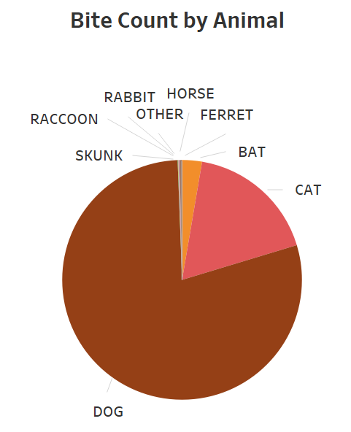
What animals bite people most frequently?
Notes:
Data collected from

Slide 7
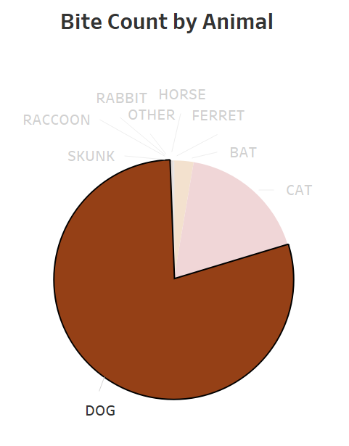
What animals bite people most frequently?
Notes:
Data collected from

Slide 8
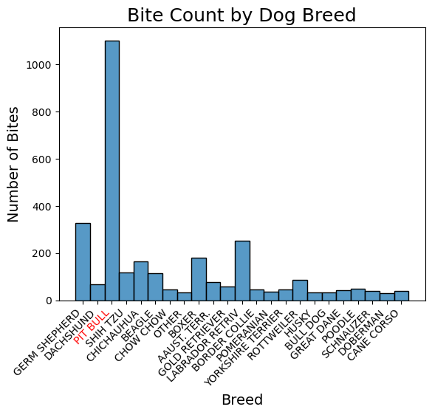
Which dogs bite people most often?
Notes:
Pit bulls are by far the most frequent offender, followed by german shepherd, labrador retriever, boxer, then chihuahua

Slide 9
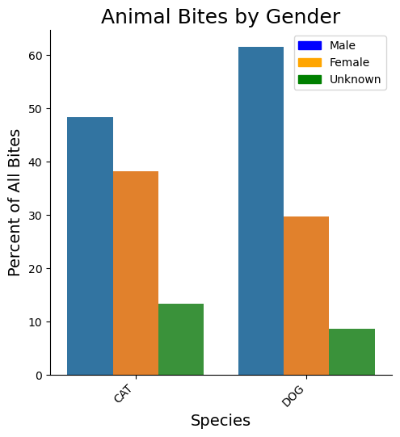
Is one gender more likely to bite?
Notes:
Whereas cats bites are almost equally split between male and female, dogs are 2:1 male to female

Slide 10
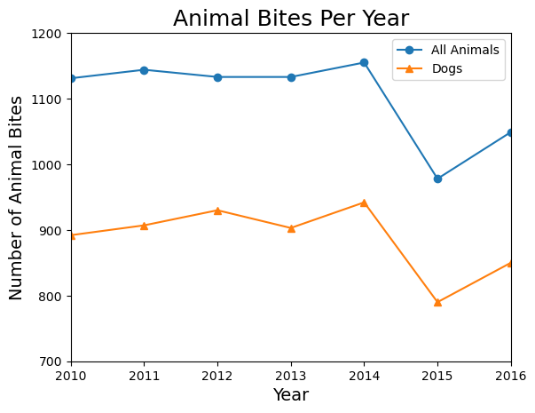
Is there a trend over the years?

Slide 11
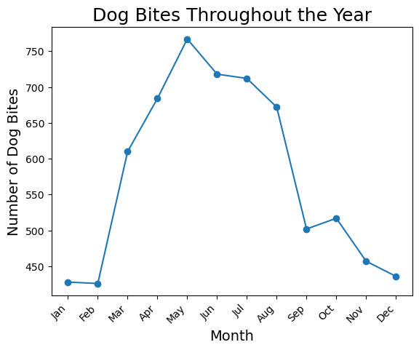
Or by month?
Notes:
This makes a lot of sense - dogs are out more often during nice weather months in April, May, June, and July before going inside when it’s peak summer through winter.

Slide 12
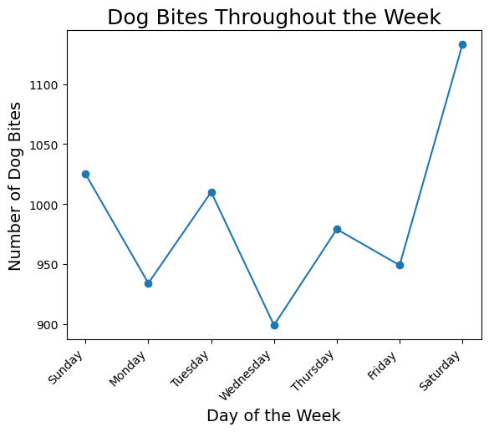
How about by day of the week?
Notes:
Look at that spike on Saturday when people are outside more often with their dogs, and maybe a drop from Saturday to Sunday due to the lack of mail delivery? Not as many mail carriers getting bitten?

Slide 13
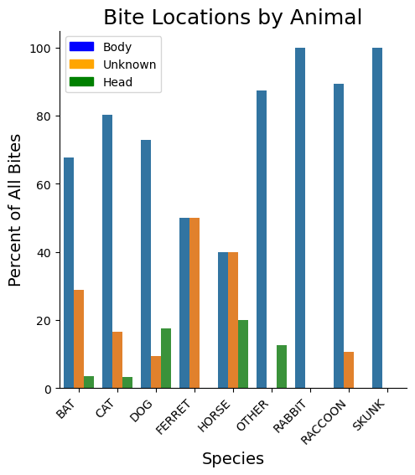
What part of the body do animals bite most often?
Notes:
While the number is still low, dogs and horses are the most likely animals to bite someone in the head at around 20%

Slide 14
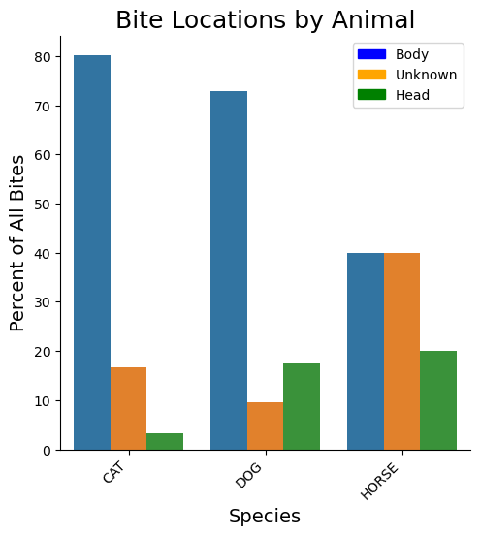
Looking closer

Slide 15
Key Takeaways
Dogs - especially pitbulls - are the biggest bite risk for people in Louisville KY
The rate of animal bites per year is relatively flat
Bite rates are much higher between March and August, likely due to warmer weather and longer days
Bites are most common on Saturdays, with a big drop to Sundays
No mail carriers to be bitten?
People are at higher risk of bites to the head with dogs and horses than any other animal

Slide 16
Key Takeaways
Dogs - especially pitbulls - are the biggest bite risk for people in Louisville KY
The rate of animal bites per year is relatively flat
Bite rates are much higher between March and August, likely due to warmer weather and longer days
Bites are most common on Saturdays, with a big drop to Sundays
No mail carriers to be bitten?
People are at higher risk of bites to the head with dogs and horses than any other animal

Slide 17
Key Takeaways
Dogs - especially pitbulls - are the biggest bite risk for people in Louisville KY
The rate of animal bites per year is relatively flat
Bite rates are much higher between March and August, likely due to warmer weather and longer days
Bites are most common on Saturdays, with a big drop to Sundays
No mail carriers to be bitten?
People are at higher risk of bites to the head with dogs and horses than any other animal

Slide 18
Key Takeaways
Dogs - especially pitbulls - are the biggest bite risk for people in Louisville KY
The rate of animal bites per year is relatively flat
Bite rates are much higher between March and August, likely due to warmer weather and longer days
Bites are most common on Saturdays, with a big drop to Sundays
No mail carriers to be bitten?
People are at higher risk of bites to the head with dogs and horses than any other animal

Slide 19
Key Takeaways
Dogs - especially pitbulls - are the biggest bite risk for people in Louisville KY
The rate of animal bites per year is relatively flat
Bite rates are much higher between March and August, likely due to warmer weather and longer days
Bites are most common on Saturdays, with a big drop to Sundays
No mail carriers to be bitten?
People are at higher risk of bites to the head with dogs and horses than any other animal

Slide 20
Key takeaway:
Beware male pit bulls on Saturdays in May!

